Slide 1
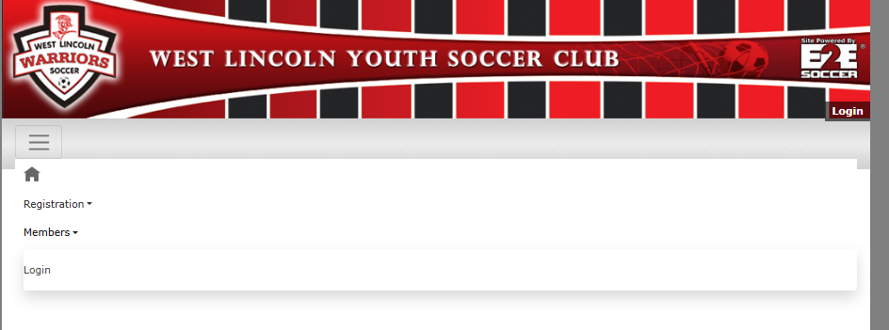
How to create a membership profile
Go to the Members tab and click Login

Slide 2
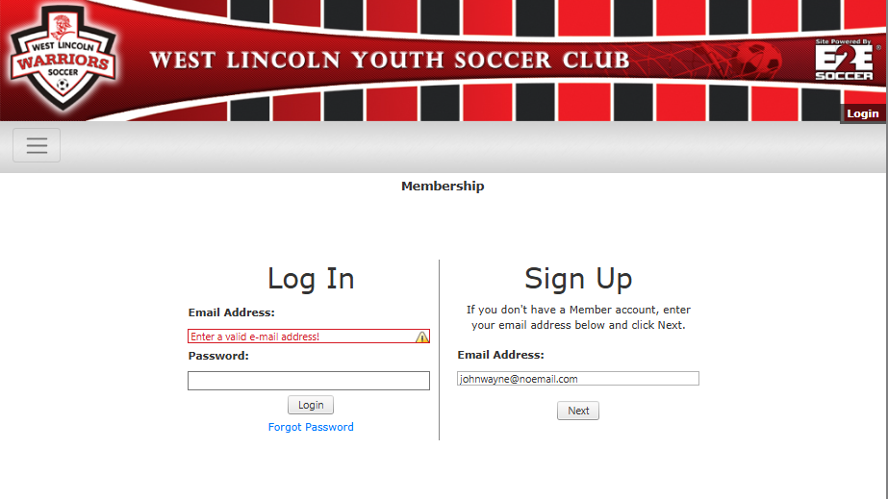
Enter your email address that you would like to use as your profile.
Click next

Slide 3
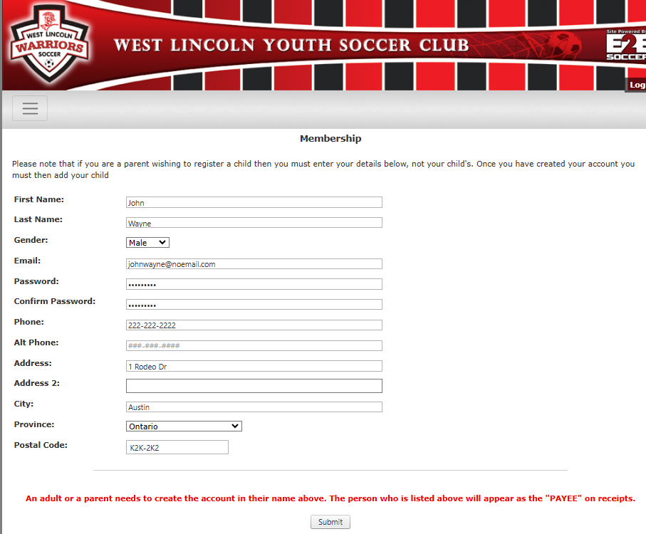
All information is required to be filled out.
Please ensure the information will appear as you wish your receipt to be listed as.
Click submit

Slide 4
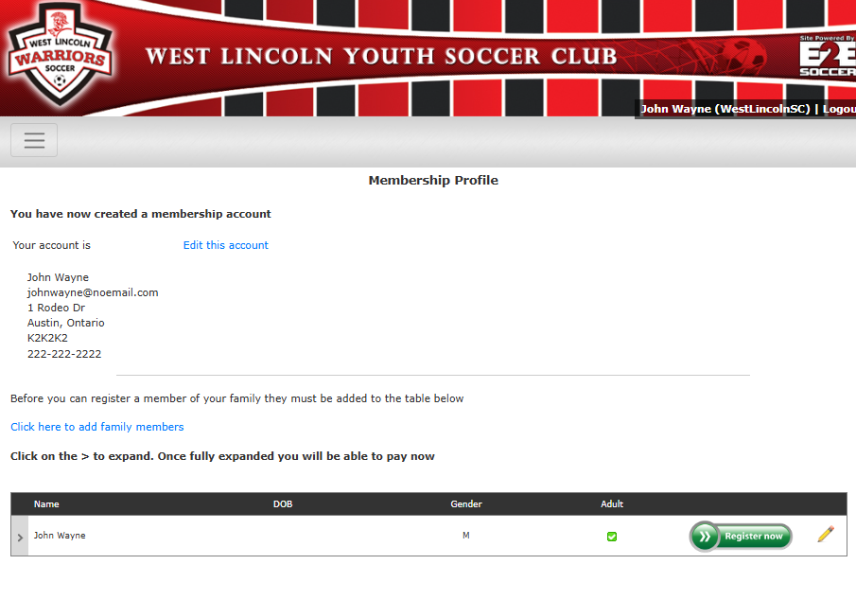
Your account is now created.
You can quickly edit your account by clicking the link.
To add family members click on the link.

Slide 5
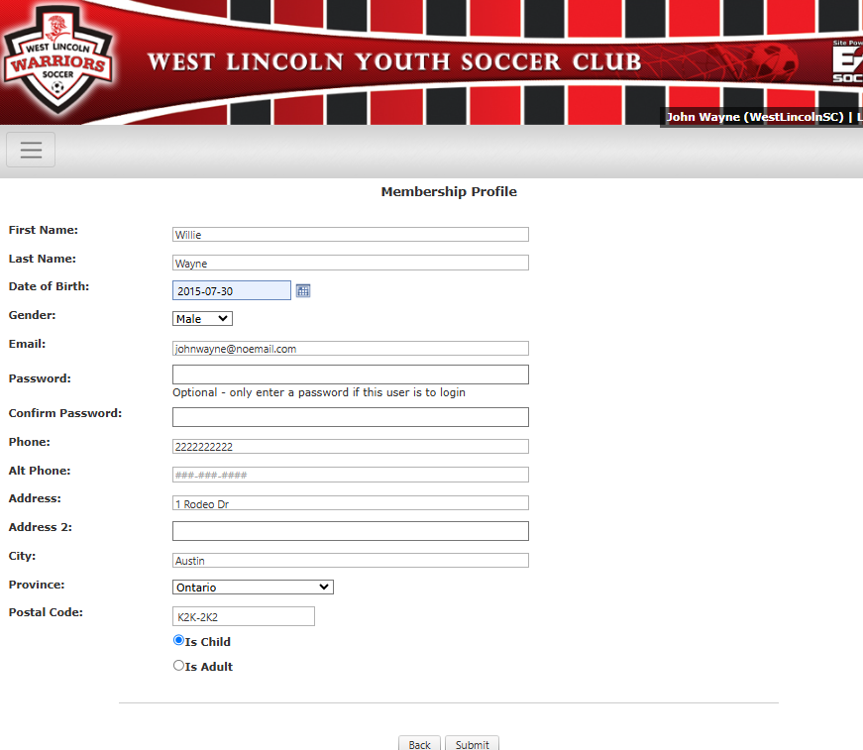
When adding family members, most of the information already provided is pre-populated.
If you are entering a child, you do NOT need to add a password unless they will be logging into the system.
If you are adding another adult, create a password and use their email address.
Ensure you mark whether this person is an adult or child.

Slide 6
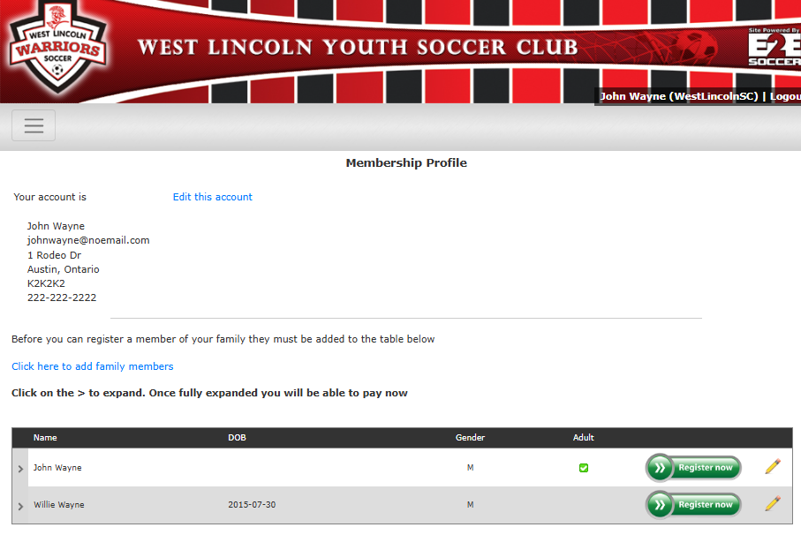
Both members of the family are now setup on the account.
To register a member, click on Register now.

Slide 7
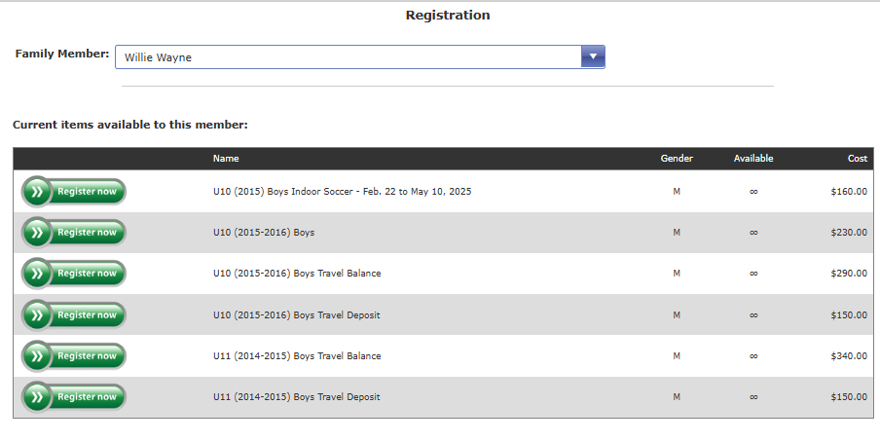
When you click on the register now button, a list of eligible programs will appear. Any program your family member is not eligible for, will not show.
Click the Register Now button to continue

Slide 8
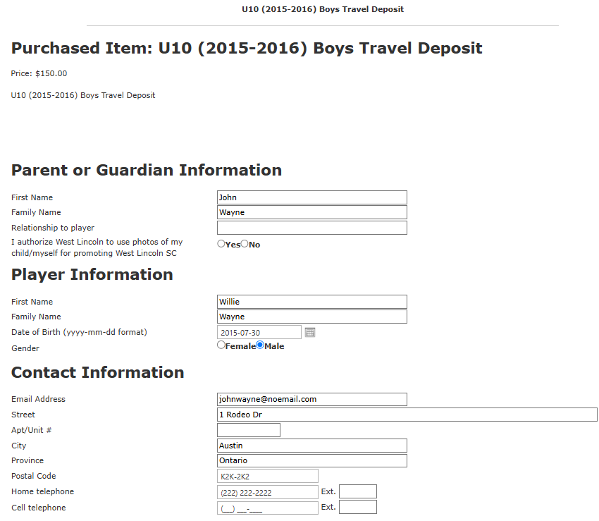
All information is pre-populated again so no need to fill out the information again.

Slide 9
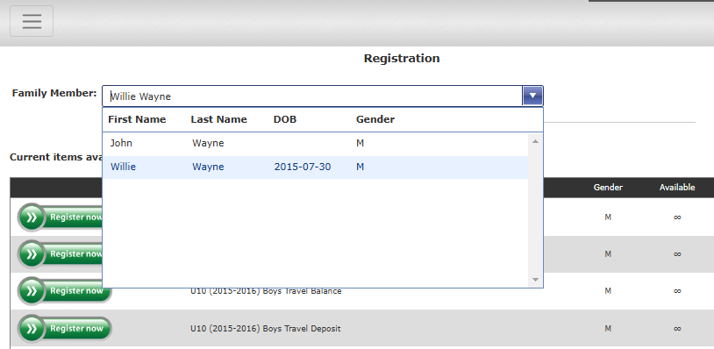
If you have multiple children you wish to register, you can toggle through them from the drop-down menu at the top.

Slide 10
After your registration is complete, you can view the programs currently registered to as well as previous registrations from past season.

